Slide 1

Cardiovascular disease analysis using machine learning methods

Slide 2
Contents.
Introduction.
Dataset.
Data preparation.
SVM Model.
Random Forest model.
Results and Discussion.

Slide 3
Introduction
Background:
Investigating machine learning for detecting cardiovascular disease using medical data comprising objective measurements, medical test results, and subjective patient information.
Problem Statement:
Develop a system to predict the likelihood of cardiovascular disease and detect its precursors, addressing its global prevalence and enabling early intervention.
Objective:
To evaluate the performance of Random Forest (RF) and Support Vector Machine (SVM) models in predicting cardiovascular disease

Slide 4

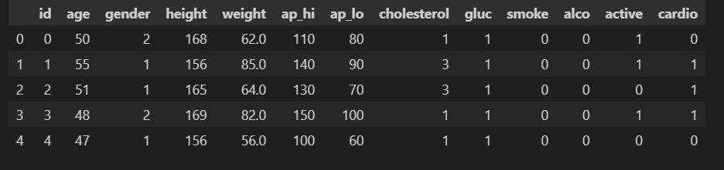
Dataset
Cardiovascular Disease dataset.
Open source dataset consistent with cardiovascular disease patient data.
Dataset has 70,000 records.
Has 11 features + 1 target value.

Slide 5
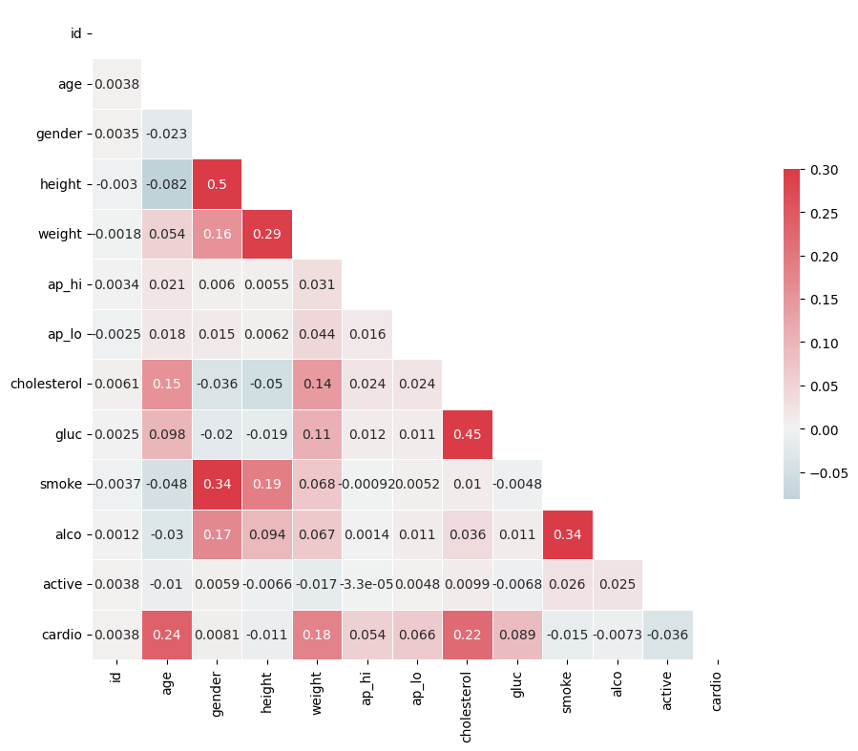
Dataset - Heatmap

Slide 6



Data preparation
Data reading
Data reading using pandas and NumPy
Data cleaning
Check for null vales
Checking for duplicate values
Outliers
Negative values.
Data manipulation
Changed Age from days to years

Slide 7
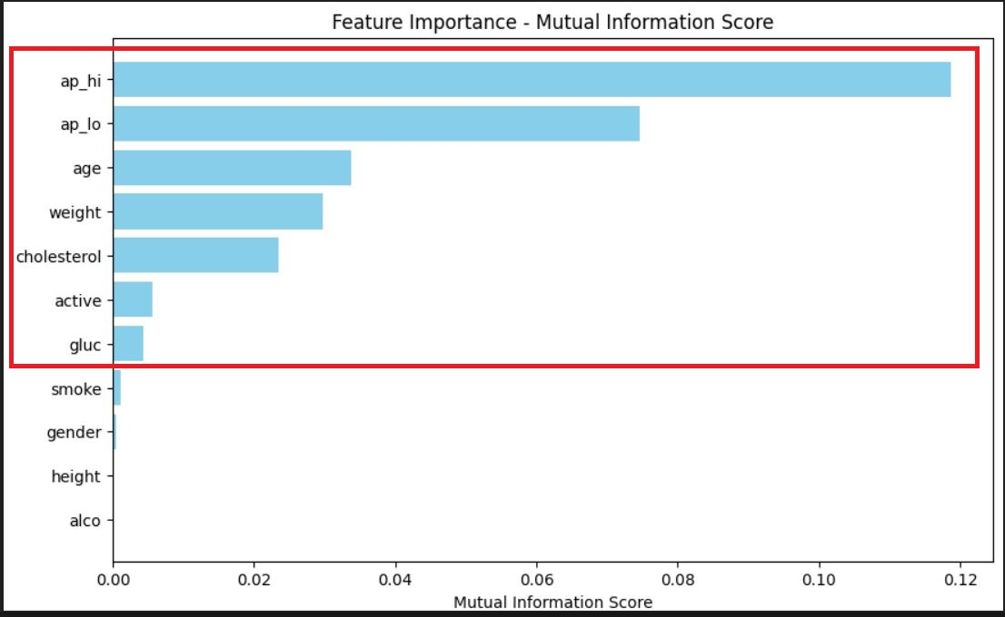
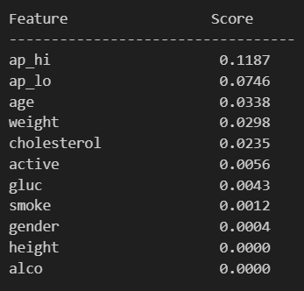
Feature Selection (MI Score)
The mutual score helps select a subset of features based on their individual importance with respect to the target variable

Slide 8

Methodology
SVM and Random forest models

Slide 9
SVM Model
Support Vector Machines (SVM) is a powerful supervised machine learning algorithm used for classification and regression tasks. It works by finding the optimal hyperplane that best separates different classes in the feature space.
Benefits:
Versatility: SVM can handle linear and non-linear data by using different kernel functions.
Regularization: It uses regularization parameter (C) to help prevent overfitting.
Key Consideration
SVMs can be computationally expensive with large datasets.
Kernel selection plays a vital role in SVM training.
Requires parameter tuning to achieve optimal performance.

Slide 10
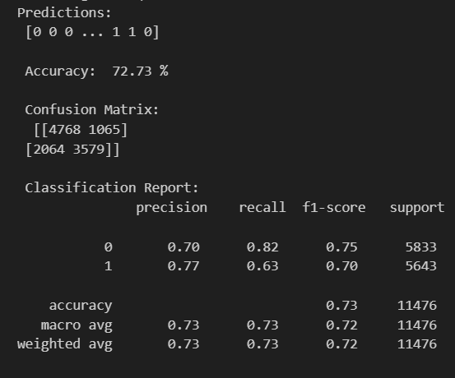
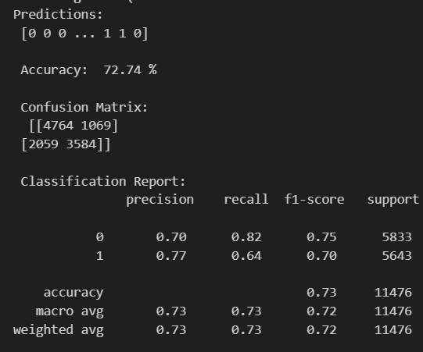
Model Training With Linear Kernel
StandardScalar()
MinMaxScalar()

Slide 11
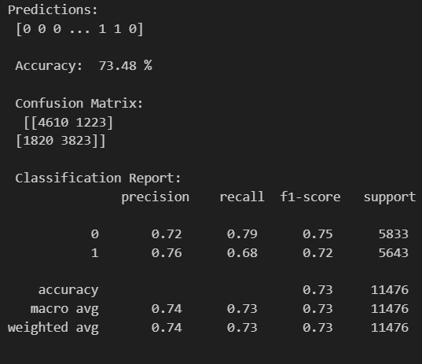
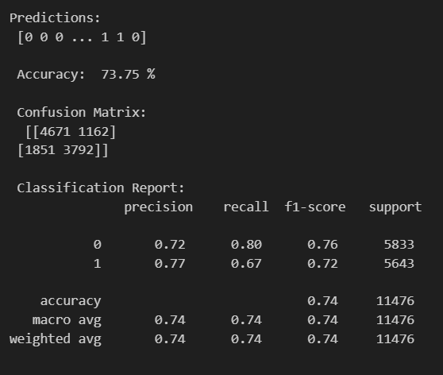
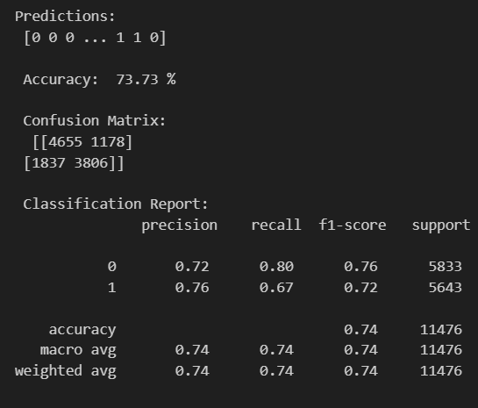
Model Training With Polynomial Kernel
Polynomial Degree 2
Polynomial Degree 3
Polynomial Degree 4

Slide 12
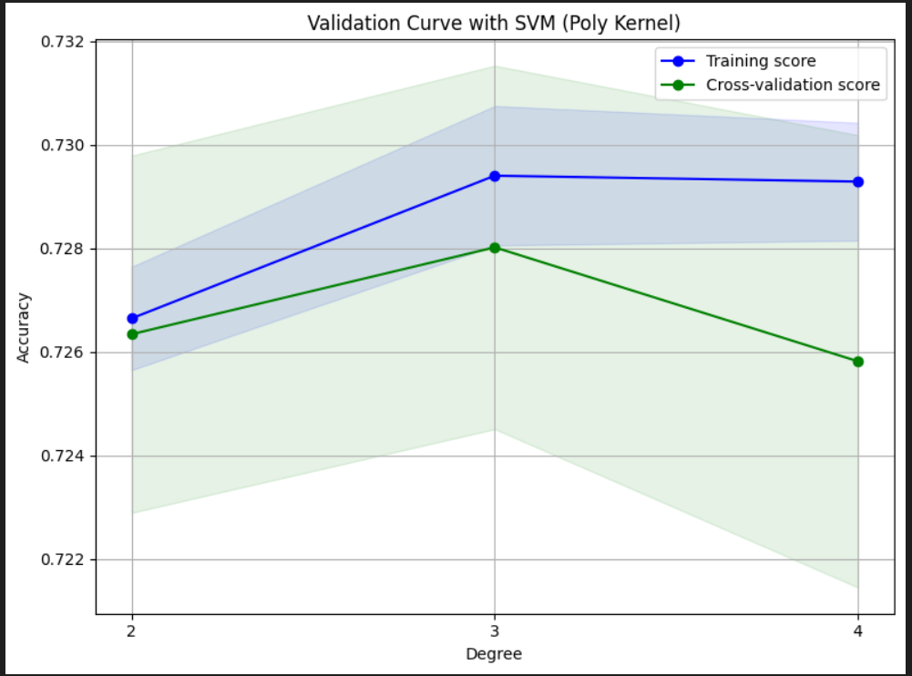
Validation Curves

Slide 13
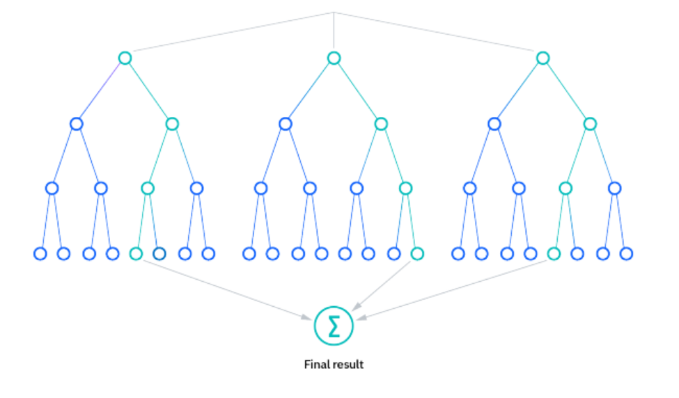
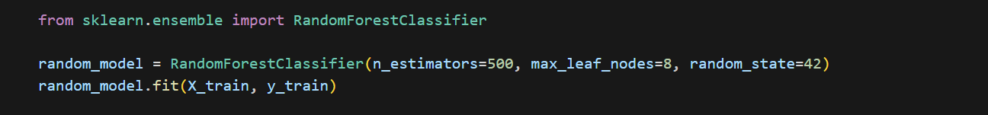
Random Forest Model
Random forest: a model that uses multiple decision trees to get a single optimized result.
Benefits.
Reduce overfitting
Flexibility
determined in feature importance.

Slide 14
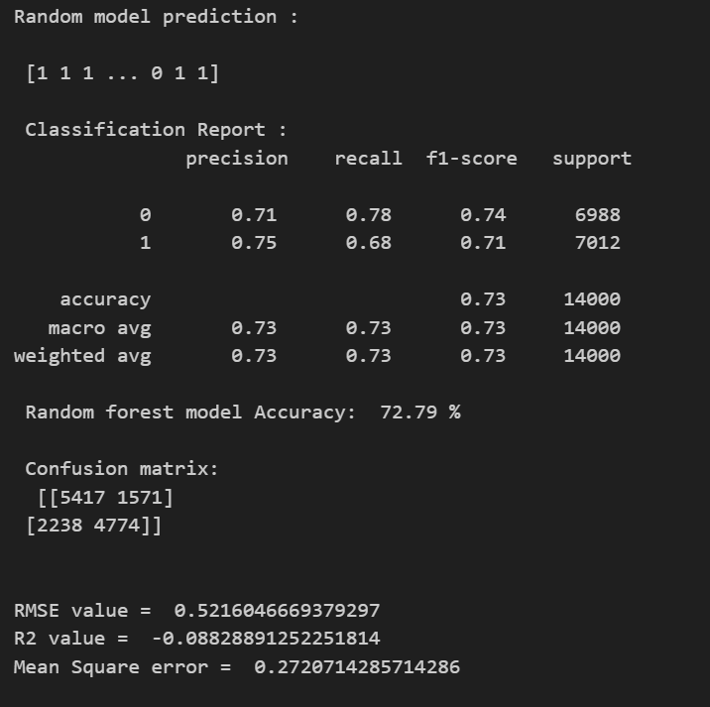

Random Forest – Evaluation
Evaluation matrix:
Accuracy
Classification Report
Confusion matrix
RMSE value
Mean Square error

Slide 15
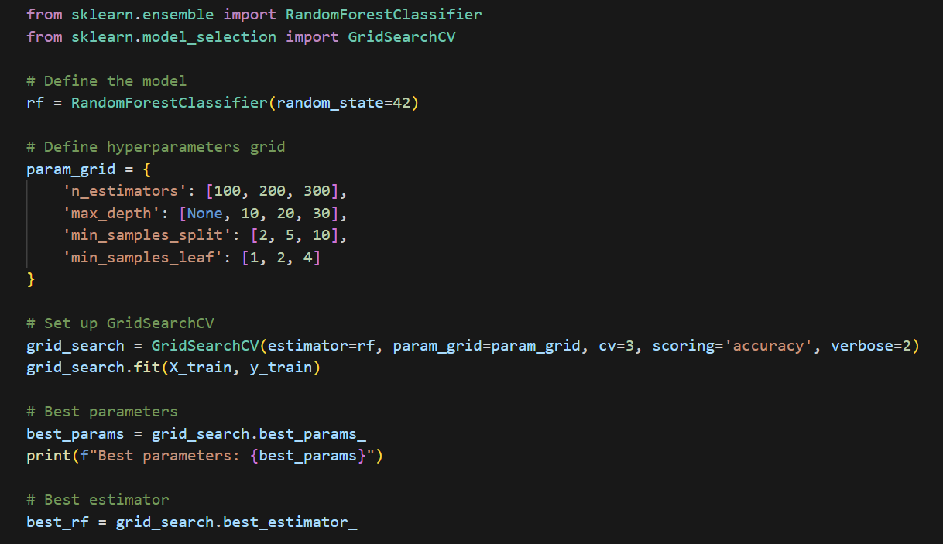


Optimization.

Slide 16
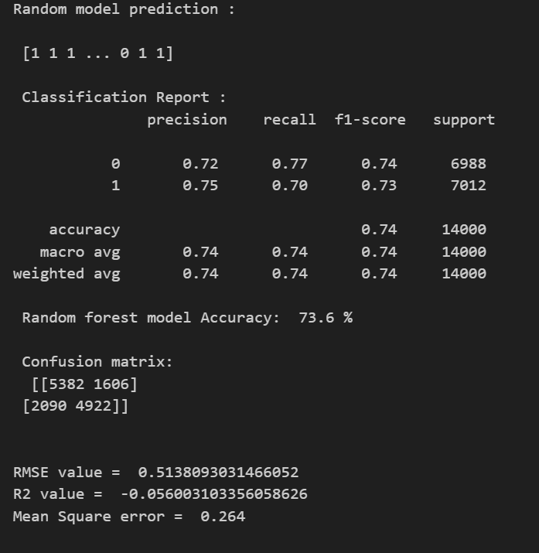

Optimization Cont.

Slide 17
Results and Comparison
Both models have similar overall accuracies of 73.6% for Random Forest and 73.75% for SVM.
The SVM model shows slightly better recall for class 0 (80% vs. 77%) but lower recall for class 1 (67% vs. 70%) compared to the Random Forest model.
The SVM have slightly better precision for class 1which is 77%, whereas random forest have 75%.
Random Forest Model
SVM Model

Slide 18

Thank You.

